Slide 1
Confusion Matrix

Slide 2
What is Confusion Matrix?
It is a table that is often used to describe the performance of classification model or classifier on a set of test data for which the true values are known.
It is used to compare predicted and actual values.

Slide 3
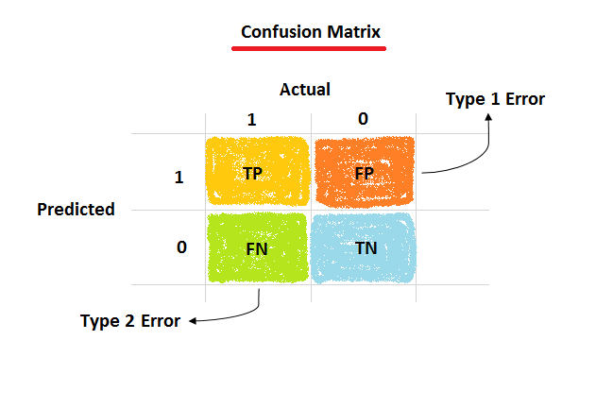

Slide 4
True Positive (TP) : Actual Positive and Predicted as Positive.
True Negative (TN) : Actual Negative and Predicted as Negative.
False Positive (FP) [Type 1 error] : Actual Negative and Predicted as Positive.
False Negative (FN) [Type 2 error] : Actual Negative and Predicted as Negative.

